Slide 1


OPRA Amendments
D2 Cybersecurity
OCTOBER SUB-FUND MEETING | OCTOBER 17, 2024

Slide 2
SUB-FUND ADMINISTRATOR REPORT
JIM RIDGWAY
J. Byrne Insurance
CAIP Sub-fund Administrator

Slide 3
NJSIG UPDATES
JOE SEMPTIMPHELTER
SENIOR BUSINESS DEVELOPMENT SPECIALIST
New Jersey Schools Insurance Group

Slide 4
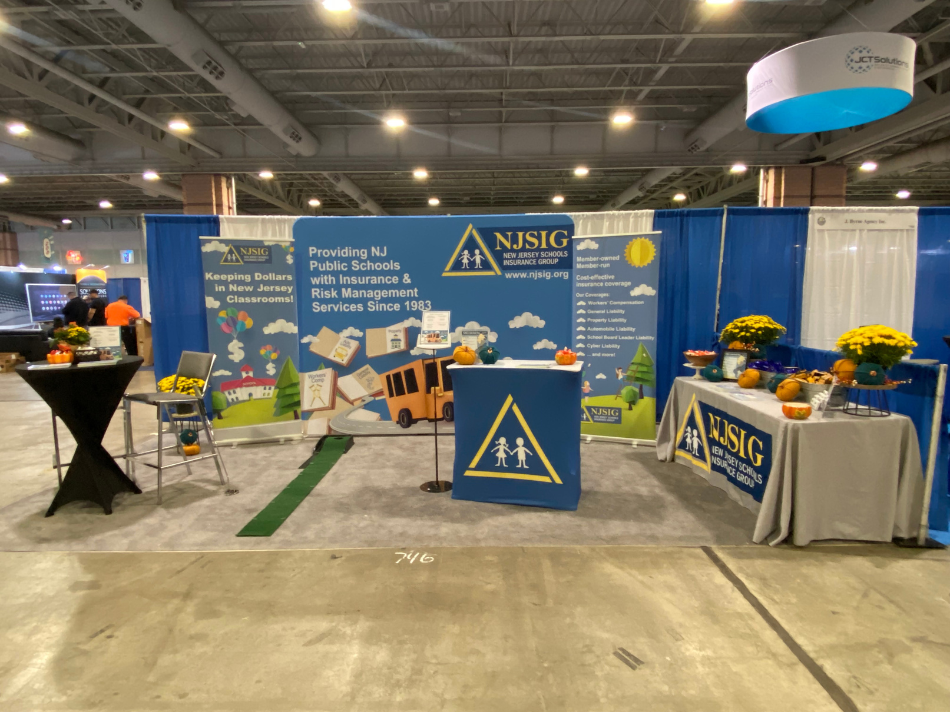

2024 NJSBA Workshop
NJSIG Presentations
Workplace Wellness: Optimizing Workers’ Compensation and Return-to-Work Programs
Tuesday, Oct 22 @ 10:30am
Wednesday, Oct 23 @ 10:00am
From Conflict to Cooperation:
Handling Ethics Issues Efficiently
Wednesday, Oct 23 @ 9:00am
Wednesday, Oct 23 @ 1:00pm
October 21-24, 2024
NJSIG Booth #740
J. Byrne Booth #744

Slide 5
E&O CLAIMS
NJSIG is now handling E&O claims in-house.
Please continue to notify your broker of the E&O claim.
Brokers should complete the ACORD form and
submit via email to: FROI@njsig.org.
Anthony Fernandez
Claims Supervisor (E&O)/Senior Policy and Claims Analyst
afernandez@njsig.org | 609-386-6060 x3060
  Note: For all claims filed before July 1, 2024, contact Summit Risk Services at NJSIGclaim@summitrisk.com

Slide 6
NJSIG gave back
$2.6 Million
in Surplus Returns!
NJSIG gave back
$2 Million
in Safety Grants!
Checks will be sent this month!

Slide 7

OPRA Update: What the Legislature Intended, and How It Could Impact Litigation.
Brett Gorman, Esquire
October 17, 2024

Slide 8
Overview
Brief History of OPRA
Changes as of September
  Individual Privacy
  Communication
  Security Footage
  Commercial Requests
  Protective Orders
  Service Fees
  Attorney's Fees

Slide 9
Brief History of OPRA
Replaced "Right to Know"
Passed in 2002
Legislative goal: “promote transparency in the operation of government”
Major Legislative Update
New Legislation went into effect September 3, 2024
Notes:
Burnett v. County of Bergen decided in 2009
Balancing test between access to documents and citizen’s reasonable expectation of privacy weighed in favor of redacting SSNs.
Gilleran v. Township decided in 2016
OPRA’s security exclusion prevented disclosure of a full day of surveillance footage outside of town hall.
Brennan v. Bergen Cnty. Prosecutor’s Office decided in 2018
Balancing test weighed in favor of disclosure of names and addresses of bidders at a public auction
L.R. v Camden City Public Sch. Dist. decided in 2019
Creates a balancing test for a court to determine whether to order the production of student records under DOE regulations.
Bozzi v. City of Jersey City decided in 2021
Balancing test weighed in favor of disclosure of dog owners names and addresses contained in dog licensing records.

Slide 10
Individual Privacy
Prior to September 3
Test: agency must protect a citizen's personal information with which it has been entrusted, when disclosure thereof would violate the citizen's reasonable expectation of privacy
After September 3
Enumerated: debit card numbers, bank account information, month and day of birth, personal email address required for government applications, services, or programs; PII disclosed on domestic animal permits; PII provided for the purpose of receiving notifications
Enumerated: SSNs, credit card numbers, much of personnel records, communications with the Legislature
Test: agency must protect a citizen's personal information with which it has been entrusted, or information that might reasonably lead to disclosure of personal information, when disclosure thereof would violate the citizen's reasonable expectation of privacy, or when the agency believes that disclosure may result in harassment, unwanted solicitation, identity theft, or opportunities for criminal acts

Slide 11
What Does This Mean?
Legislature has sent a message to the courts about interpreting the privacy it intends to be provided under OPRA.
In Bozzi, the Supreme Court required Jersey City to disclose the names and addresses of dog owners which had been disclosed to the City in compliance with the law to register their dogs. The Court appeared to express some frustration with OPRA stating; "We are bound by the language of OPRA and the intent of the Legislature in safeguarding personal information. The inadequacies complained of by Governor McGreevey and the recommendations made by the Privacy Study Commission were not corrected or adopted by the Legislature. Thus, we continue to abide by the plain language of the statute and its fundamental policy favoring disclosure."
Bozzi was explicitly overturned by an enumerated exemption. Bozzi may have also inspired the changes to requests with commercial intent.
In Rise Against Hate, the Appellate Division found that citizens had a reasonable expectation of privacy in their email addresses provided to subscribe to Township newsletters. The exemption was codified by an enumerated exemption.

Slide 12
Litigation Strategy
For litigation purposes it will be a compelling to note that the Legislature has clarified where it stands on the issue of individual privacy, sending a message with this recent OPRA update that individual citizens who are disclosing personal information to the government to comply with the law and/or be informed about government activities should not expect that information to be disclosed.
Note that in Brooks, the Appellate Division found that "it is least colorable that a member of the public would expect that their name, email address, the fact that they communicated with a municipal official or employee, and the subject matter of that communication would not be readily subject to public disclosure". Despite this arguably reasonable assumption, the public's naivety was outweighed by the information sought going to the heart of the purpose of OPRA: to root out corruption through transparency. This holding was not overturned and may create an important limit to the above argument.

Slide 13
Communications
Prior to September 3
OPRA required disclosure of communication between government officials unless otherwise exempt.
After September 3
OPRA exempts a request including for mail, email, text messages, correspondence, or social media postings and messages, if the request
(1) does not identify a specific job title or accounts to be searched, a specific subject matter, and is not confined to a reasonable time period or
(2) if the request would require research and collection of information and the creation of a new government record setting forth the researched information

Slide 14
What Does This Mean?
The new limit on requests for communication is a codification and possibly expansion of the case law that has grown around MAG, a case that has been cited in 100 cases since 2005, regarding when an OPRA request is "overbroad".
In Burke, the Appellate Division found that a request for all correspondence between the Office of the Governor and the Port Authority regarding EZ Pass benefits was not overbroad because it was confined to a clearly described subject matter and limited to particularized identifiable government records, namely, correspondence with another government entity.
More recently, the Appellate Division found that a request for "all correspondence related to [the Police Accountability Project]" was overbroad because it was a request for general information to be analyzed, collated and compiled.
Notes:
MAG Entm't, LLC v. Div. of Alcoholic Beverage Control, 375 N.J.Super. 534, 543 (App.Div.2005).

Slide 15
Litigation Strategy
The Legislature's move to codify and even slightly expand the courts' interpretation "overbroad" requests for communication demonstrates that both the Legislature and the courts find it necessary, under OPRA, to protect agencies from burdensome requests. Such an argument will likely be persuasive when defending a request for communications that was denied as overbroad.
  Remember: OPRA rewards collaboration, so encouraging clients to calculate what would be reasonable and offer to provide the records with a special service charge over a longer timeframe will be preferred to a flat denial.

Slide 16

Security Footage
Prior to September 3
Security Footage:OPRA exempted
After September 3
Security: OPRA exempts security alarm system activity and access reports, including video footage, for any public building, facility, or grounds unless the request identifies a specific incident that occurred, or a specific date and limited time period at a particular public building, facility, or grounds, and is deemed not to compromise the integrity of the security system by revealing capabilities and vulnerabilities of the system
(1) emergency or security information or procedures for any buildings or facility which, if disclosed, would jeopardize security of the building or facility or persons and
(2) security measures and surveillance techniques which, if disclosed, would create a risk to the safety of persons, property, electronic data or software.

Slide 17
What Does This Mean?
The changes to the security exemptions appear to be a codification of the rules developed by Gilleran interpreting the security exemptions for security footage.
Gilleran found that hours of footage outside town hall and the police station was within OPRA's security exemption because the township established that it would reveal weaknesses in the security system and jeopardize the safety of individuals in the footage.

Slide 18
Litigation Strategy
The updates to the security exemptions affirms that security footage is exempt from OPRA unless the requestor has a limited and clearly defined request AND the disclosure would not expose weaknesses in the security system OR the security of those captured by the video. This provides three avenues to deny a request for security footage.
  Note: Gilleran and a later Appellate Division case interpreting Gilleran, Zezza, put the burden of showing that the footage could jeopardize security on the public agency. The language interpreted in Gilleran and Zezza only exempted footage that if disclosed would jeopardize security. The new language is open to the interpretation that the burden falls on the requestor by presuming that footage is not disclosable unless it is deemed not to compromise security.

Slide 19
Commercial Requests
Prior to September 3
In most cases, purpose was not considered relevant to whether a request was able to be denied under OPRA.
After September 3
“Commercial purpose” is defined as " direct or indirect use of any part of a government record for sale, resale, solicitation, rent, or lease of a service, or any use by which the user expects a profit either through commission, salary, or fee.
Requestors must indicate if their request has a commercial purpose in the request for the request to be considered.
Commercial requests have a 14, rather than 7, day timeline and if a commercial requestor would like a seven-day timeline they can be charged a special service fee.
A commercial requestor who fails to certify the same shall be subject to a civil penalty of $1,000 for the first offense, $2,500 for the second offense, and $5,000 for each subsequent offense. The penalties may be imposed by the courts.

Slide 20
What Does This Mean?
Justice Albin, in his dissent in Bozzi, wrote: "I agree with the majority that the purpose behind the request is generally not relevant to our threshold inquiry of whether a reasonable expectation of privacy exists. Our case law has made clear that an entity seeking records for a commercial purpose has the same right to available records as anyone else."
The "actions" taken on commercial use may be another Legislative response to this case.
Notes:
MAG Entm't, LLC v. Div. of Alcoholic Beverage Control, 375 N.J.Super. 534, 543 (App.Div.2005).

Slide 21
Litigation Strategy
This Legislation overturned Bozzi with an explicit exemption for dog licensing information and had added the definition of commercial purpose and the requirement that such purpose be disclosed, but, interestingly tied no new exemptions to a commercial purpose.
It appears that other than being required to disclose their intention and having to wait longer for a response, commercial requestors continue to enjoy "the same right to available records as anyone else."
A request with a commercial purpose may reduce the impact of Brooks, which held that a colorable argument for an expectation of privacy was outweighed by a request that went to the heart of rooting out corruption, in an argument that pits a commercial purpose against a citizen's reasonable expectation of privacy. (See slide 6 for the initial Brooks discussion)

Slide 22
Protective Orders
Prior to September 3
After September 3
Not addressed in OPRA legislation. Does not appear to have been granted by the court when sought under Fed. R. Civ. Pro. 26 or NJ Ct. R. 4:10-3 where OPRA was being used as a discovery tool.
Agencies may file a complaint in Superior Court that an OPRA request was made with the intent to substantially interrupt the performance of government function.
The complaint must include a declaration of facts demonstrating that the agency has complied with OPRA and has made a good faith effort to reach an informal resolution of the issues.
The Court must find by clear and convincing evidence that the requestor intended to substantially interrupt the performance of government function.
Under these circumstances, the Court can issue a protective order limiting the number and scope of requests the requestor may make or order other relief as it deems appropriate.

Slide 23
What Does This Mean?
The ability to seek protective orders; the limitations on disclosure of communications; and the new prohibition on requesting "a government record if the record sought is the subject of a court order, including a pending discovery request" may indicate that the Legislature was responding to records custodians' input on where OPRA was a hinderance to a functioning agency.

Slide 24
Litigation Strategy
To receive a protective order under OPRA, the agency must show intent by clear and convincing evidence.
Litigators can look to defamation cases in which plaintiffs need to establish by clear and convincing evidence that a defendant intended to defame them or legal fraud cases in which the plaintiff must establish by clear and convincing evidence that the defendant knew they were lying and intended the plaintiff to rely on the lie.

Slide 25
Service Fees
Prior to September 3
a public agency may routinely charge any party the actual cost of duplication of government records and if the production of government records involves an extraordinary expenditure of time and effort, the agency may impose a special service chargethat shall be reasonable and shall be based upon the actual direct cost of providing the copy or copies.
After September 3
If a public agency converts the record to a requested medium or format, the agency may charge, in addition to the actual cost of duplication, a special service fee that shall be reasonable and shall be based on the cost for any extensive use of information technology, or for the labor cost of personnel providing the service, that is actually incurred by the agency.
If a commercial requestor would like to receive the record within seven business days, the custodian shall provide the requestor with a copy of the record and may charge a special service fee not exceeding two times the cost of the production of the record.
The custodain shall provide the requestor with an explanation for and itemized list of fees. If the requestor objects to the fees or charges, the burden of proof shall be on the requestor to demonstrate that the fees or charges are unreasonable.
If a requestor is unable to locate a record that is available online and requests a physical copy, the custodian shall provide the requestor with a physical copy of the record, for a fee not exceeding two times the cost of the production of the document.

Slide 26
What Does This Mean?
Agencies no longer bear the burden of proof that fulfilling a requestor's OPRA requests would require an extraordinary expenditure of time and effort, which warrants a special service charge because such charges are presumed to be reasonable.
The GRC has a 14-point analysis regarding the necessity of a special service charge. The analysis required the custodian to fill out a detailed description of the request and the process required to fulfill the request. It is likely this analysis will not survive the burden shifting to the requestor.

Slide 27
Litigation Strategy
Although the GRC 14-point analysis will likely no longer be used as a tool by the GRC to determine if a service charge is reasonable, it can serve as a guide to writing a brief in defense of a challenged service charge because it indicates the categories the GRC looks at when determining reasonableness.

Slide 28
Attorneys' Fees
Prior to September 3
A requestor who prevails in any proceeding shall be entitled to a reasonable attorney’s fee.
A requestor who prevails in any proceeding may be entitled to a reasonable attorney’s fee.
After September 3
If the public agency has been determined to have unreasonably denied access, acted in bad faith, or knowingly and willfully violated OPRA then the court or GRC shall award a reasonable attorney’s fee.

Slide 29
What Does This Mean?
Fee shifting was considered a cornerstone of OPRA:
"Without that fee-shifting provision, 'the ordinary citizen would be waging a quixotic battle against a public entity vested with almost inexhaustible resources. By making the custodian of the government record responsible for the payment of counsel fees to a prevailing requestor, the Legislature intended to even the fight.'" NJDPM, 2005.
This is a big shift away from viewing municipalities, school districts, fire stations, and other small, tightly budgeted agencies of local government as a public entity vested with inexhaustible resources.
The Legislature maintained the ability of the courts to impose attorney fees on a discretionary basis and to require such fees in cases of intentional violations of OPRA likely to maintain the compelling pressure of attorney fees in motivating prompt compliance with OPRA and the resulting government transparency.

Slide 30
Litigation Strategy
Previous cases that considered attorneys' fees under the common law right to access, which only allows such fees in instances of bad faith, can shed light on a possible analysis and may be persuasive.
In Gannett Satellite Information Network, the court denied fees because "the Township advanced good faith arguments in support of its contention …[; t]he trial court found a right of access but only after a careful examination of the relevant factors … ; [there [was] no reason to assume that [the plaintiff was] not able to bear the cost and expense of pursuing this lawsuit, and the denial of fees under the particular facts and circumstances presented, would not dissuade other litigants from pursuing such claims."
A similar set of facts, now under OPRA, could prove compelling in arguing against the award of attorney's fees.

Slide 31
Thank you!
Brett Gorman, Esquire
October 17, 2024

Slide 32
Thank you

